Slide 1
Asia Pacific
AUSTRALIA
TAIWAN
HONG KONG
SINGAPORE
MALAYSIA
Notes:
United States, Canada, Mexico, Bahamas, Columbia, Dominican Republic, Ecuador, Panama, Jamaica
United Kingdom, Spain
Australia, Taiwan, Hong Kong, Singapore, New Zealand

Slide 2
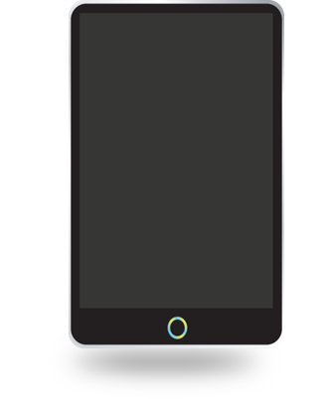
1 Account 5 Markets
Australia
2003
Singapore
2014
Taiwan
2005
Malaysia
2017
Hong Kong
2007
Over 93 Million Opportunities

Slide 3
Develop your Retail Business
SHOP.COM (Asia)
Start your business with Base 10 7 Strong
Retail products in each market
Receive retail profit into your home-country account
Earn & Use &
in each market

Slide 4
Build your Organization

Slide 5
Leverage with GMTSS
0
Mar 03 - Local Seminar ,Lisa & Yardley Lieberman-Wang (US)
Mar 11 - Basic Five, Charles Jr & Margaret Baer (US)
Mar 04 - WCT 101, Lisa & Yardley Lieberman-Wang (US)
May 24 - UBP Meeting, Sue & Phil Guido (US)
June 16 - Local Seminar, Frank Chang (TWN)
Learn from the best leaders (locally & globally)
0
Mar 18 - Local Seminar, YK Tam (HK)
Mar 10 - Local Seminar, James Kuo (US)
Jun 30 - Local Seminar, Katherine Yin (CA)
Jun24 - Local Seminar, Alice Chen (CA)
Sep 8 - Local Seminar, Peng MeiShan (CA)
0
Jan 14 - Local Seminar, Joanne Hsi (US)
Jan 26 – Product Training, Dr Wang Chi Ling (TW)
Feb 26 – Product Training, Dr Chu-Ya Yang (TW)
July 21 - Local Seminar, Katherine Yin (CA)
Learn from standardized materials
0
Jan 13 - Local Seminar, Tom Holden (US)
Mar 3 - Local Seminar (Mandarin), Johnny Huang (TW)
Apr 21 - Local Seminar (English), Ryan Stack (US)
May 1 - B5, Jim Winkler (US)
Jun 30 - Local Seminar (Mandarin), Janice Lin and Geoffrey Tsai (TW)
Grow and taking classes at your own pace
Mar – Local Seminar, Frank Chang (TW)
Apr – B5, Stacy Tung (TW)
Mar – Product Training, YK Tam (HK)
Mar – B5, Steven Hu (US)

Slide 7
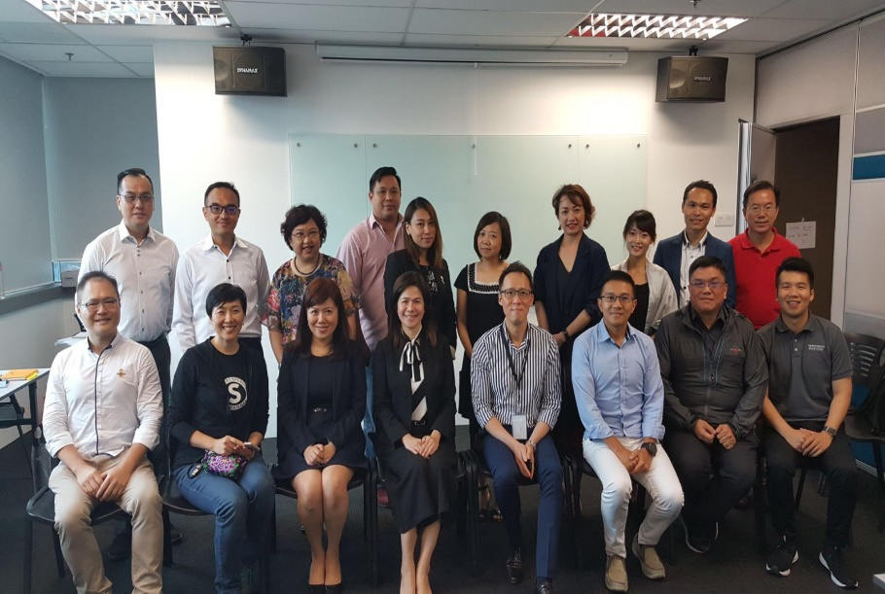
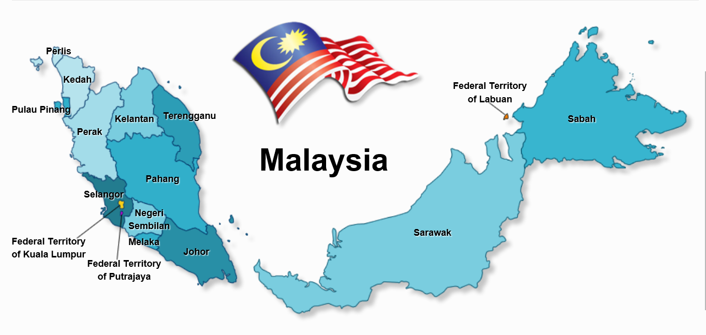

Slide 9
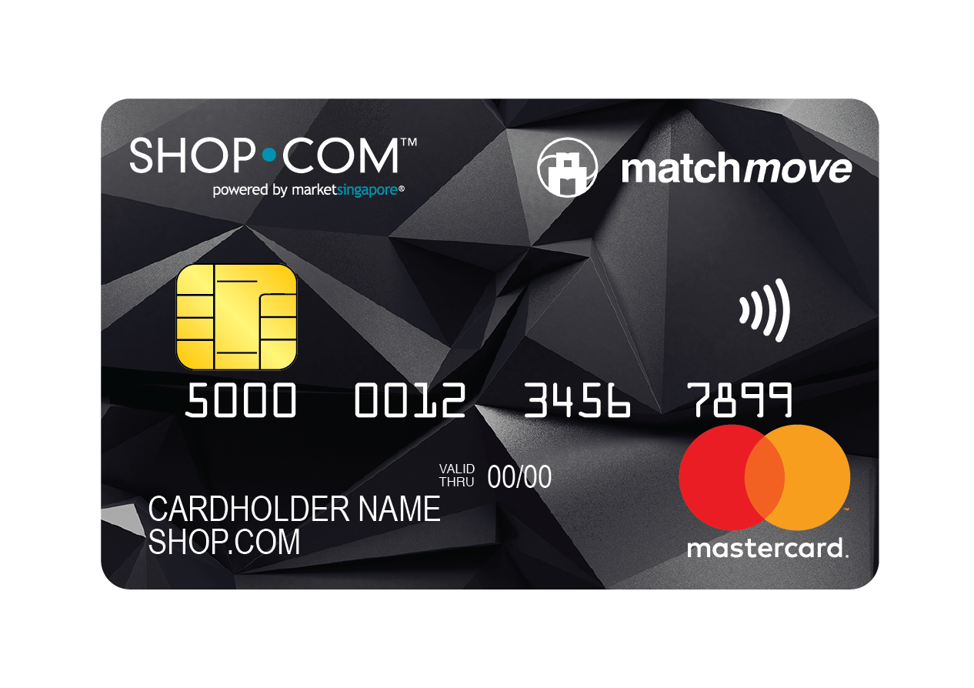
Market Singapore® SHOP.COM Prepaid MasterCard
Officially Launched in Feb 2018
Retail at S$50.00
With preload value of S$20.00
Easy Record Tracking for all SHOP Local transactions
3% Cashback, 3% IBV
*For each card you ordered
Notes:
added

Slide 10
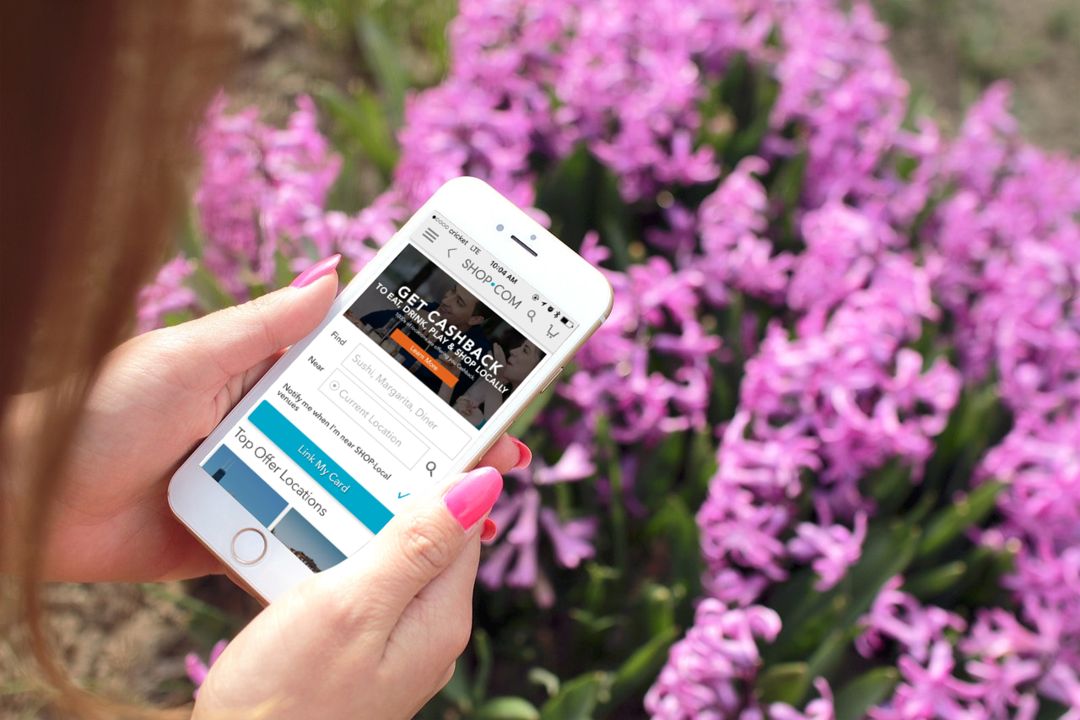
We made it easier to find local merchants
WE NOW HAVE…
220+
local merchants in 2018

Slide 13
Walk In Partner Store Merchant APP
C
Go Shopping
Present your Hong Kong SHOP.COM Privilege ard
Partner Store scan your QR code
Transactions detail uploaded on UFMS within 5 DAYs

Slide 14
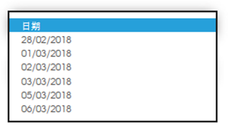
Delivery Date / Time selection

Slide 16
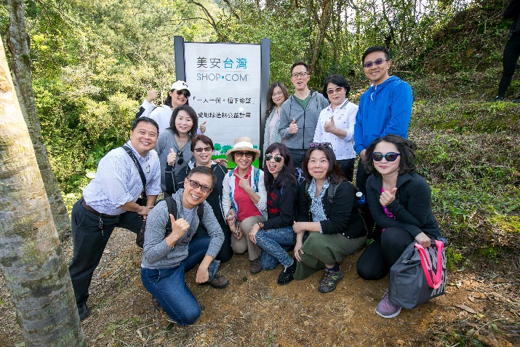
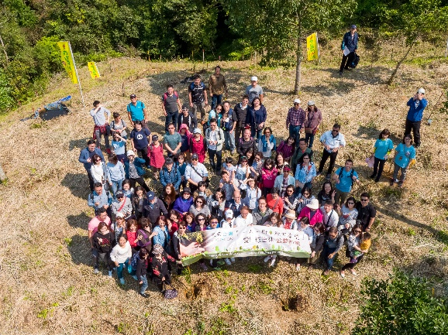
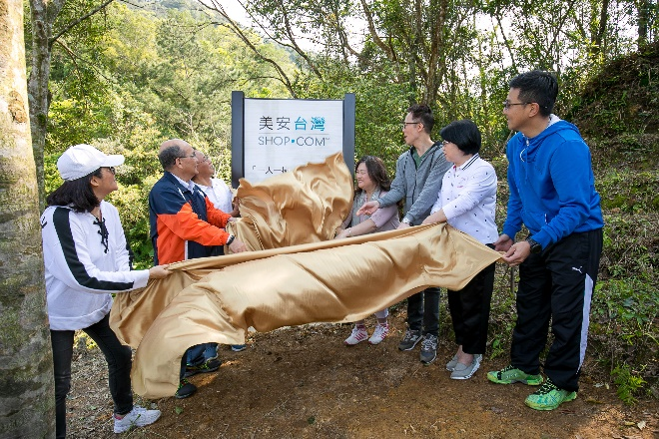
The First Market America - Market Taiwan Forest!

Slide 17
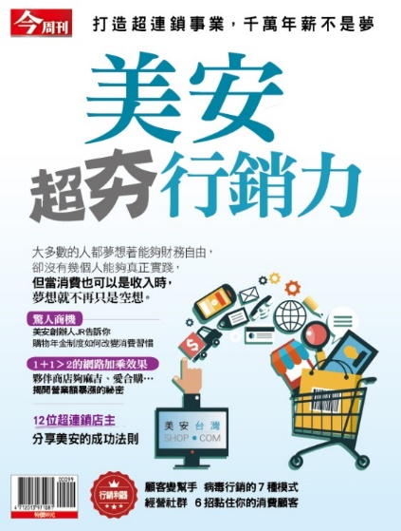
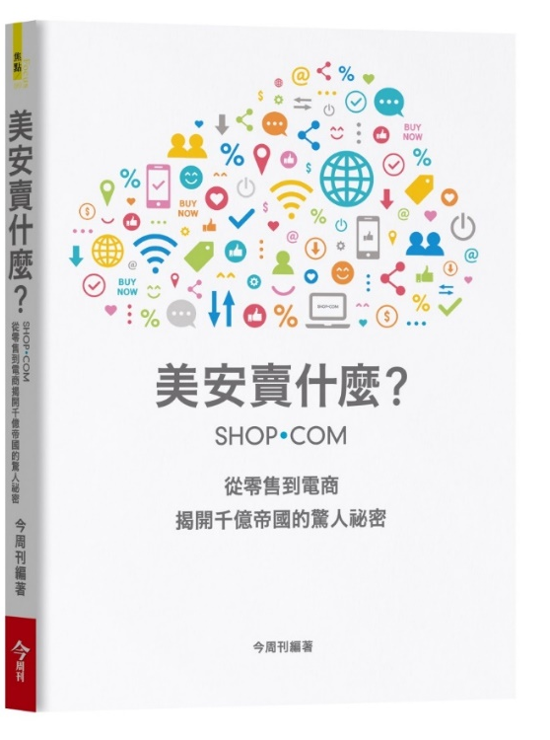
Media Exposure
Best Seller
Best Seller
Note: Ranking by Kingstone Book Store

Slide 18
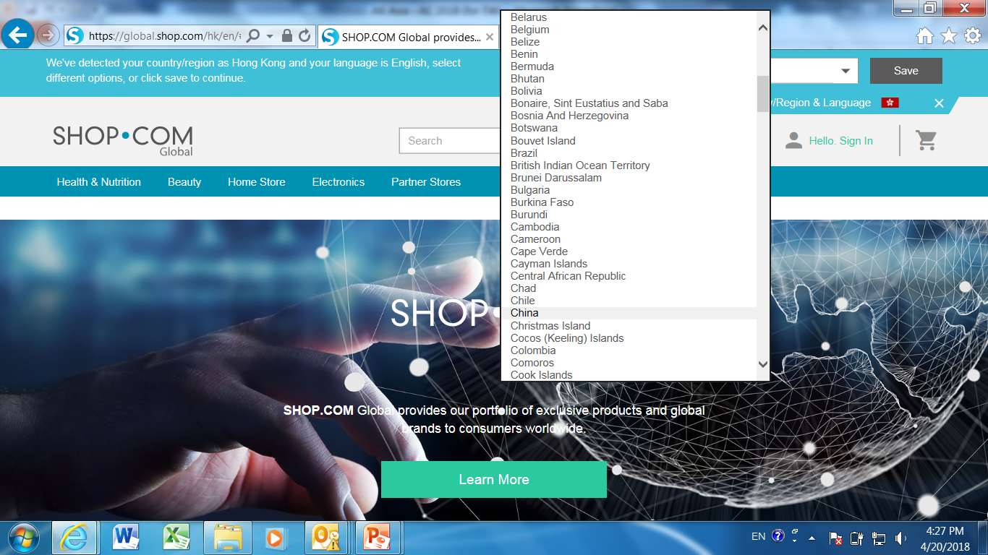
Retail MA Products in Outside World
Earn Retail Profit
Earn BV
Help people to improve health

Slide 19
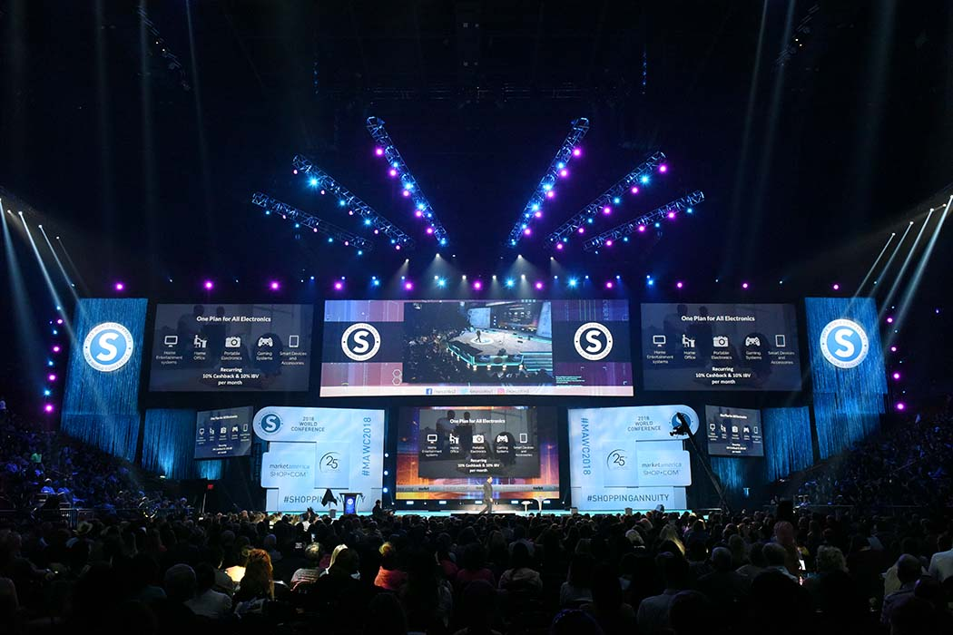
Develop Overseas Markets
Start retailing in each SHOP.COM site
01
Contact your people you know in each location
02
Attend Training / Events in other markets
03
04
Generate sales

Slide 20
2018 Upcoming Events
Product Symposium
Leadership School
Jun 30 – Jul 1
Oct 19 - 21
Jul 1
Oct 26 - 28
Jul 14 - 15
Nov 2 - 4
Jul 21 - 22
Nov 9 - 11

